Slide 1
Web Searching & Indexing
Imran Siddiqi
imran.siddiqi@mcs.edu.pk
Computer Science Department
College of Telecommunication Engineering
National University of Sciences and Technology

Slide 2
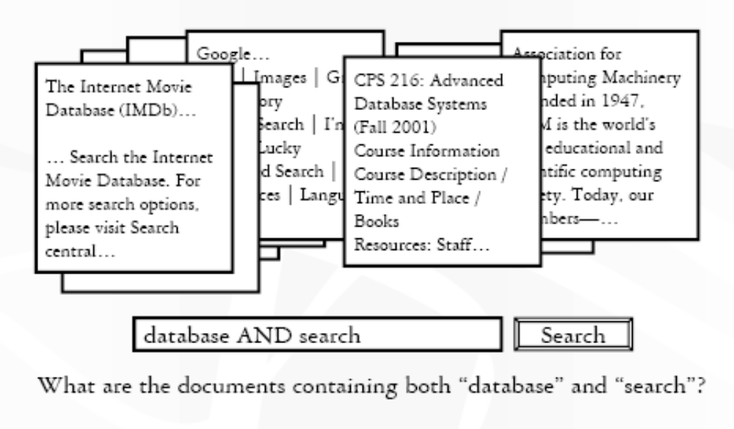
Keyword Search

Slide 3
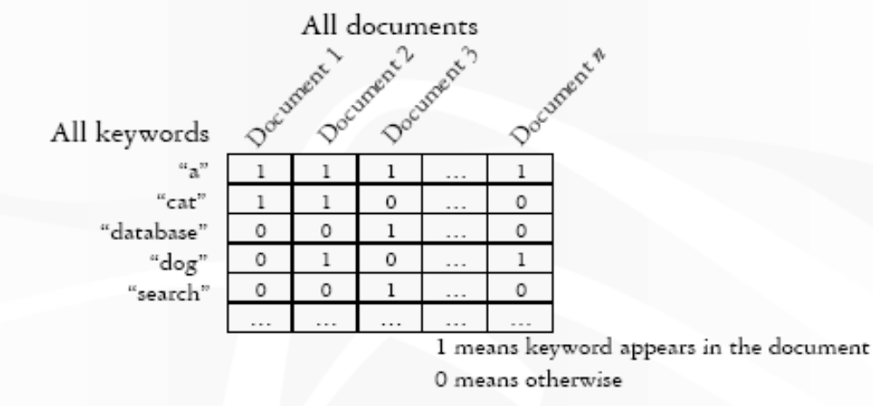
Keywords x Documents

Slide 4
Forward Index
The forward index stores a list of words for each document
Document 1 | the,cow,says,moo
Document 2 | the,cat,and,the,hat
Document 3 | the,dish,ran,away,with,the,fork
Forward Index

Slide 5
Inverted Index
The | D1, D2, D4, D5
Book | D3, D7, D8
table | D1,D2,D10,D12
… | ….
Inverted Index

Slide 6
Inverted File Index
Contains a list of references to documents for each word
Given the Documents
D0 = "it is what it is",
D1 = "what is it"
D2 = "it is a book“
The inverted index file is:
"a": {D2}
“book": {D2}
"is": {D0, D1, D2}
"it": {D0, D1, D2}
"what": {D0, D1}

Slide 7
Inverted File Index
"a": {D2}
“book": {D2}
"is": {D0, D1, D2}
"it": {D0, D1, D2}
"what": {D0, D1}
Searching for the terms "what", "is" and "it" would give the set

Slide 8
Full Inverted Index
Additionally contains the positions of each word within a document
Given the Documents
D0 = "it is what it is",
D1 = "what is it"
D2 = "it is a book“
The full inverted index is:
"a": {(D2, 2)}
"book": {(D2, 3)}
"is": {(D0, 1), (D0, 4), (D1, 1), (D2, 1)}
"it": {(D0, 0), (D0, 3), (D1, 2), (D2, 0)}
"what": {(D0, 2), (D1, 0)}

Slide 9
Stemming
Stemming provides with ways of finding variants of search terms.
- Stemming used to reduce the size of index files
Example: The ing, ed in the following example
Term | Stem
Engineering Engineered Engineer | Engineer Engineer Engineer

Slide 10
Stop Words
Stop Words not indexed
    For reducing index space and improving performance
    to, the, it, be, or, …

Slide 11
Signature Files
Characteristics
  Word-oriented structures based on hashing
  Suitable for not very large texts/collections
  Inverted files outperform signature files for most applications

Slide 12
Construction and Search
Word-oriented structures based on hashing
  Maps words to bit masks of B bits
  Divides the text in blocks of b words each
  The mask is obtained by bitwise ORing the signatures of all the words in the text block.
Search
  Hash the query to a bit mask W
  If W & B_{i} = W, the text block may contain the word

Slide 13
Example
Four blocks:
This is a text. A text has many words. Words are made from letters
000101 110101 100100 101101
  Hash(text) = 000101
  Hash(many)= 110000
  Hash(words)= 100100
  Hash(made)= 001100
  Hash(letters)= 100001
Block 4: 001100
OR 100001
101101
Does block 2 contain ‘many’?
  110000 & 110101 = 110000
YES

Slide 14
Example
Hash(‘databases’) = 0110
Hash(‘dog’) = 1100
Hash(‘cat’) = 0010
Doc 1 contains ‘databases’ – Signature 0110
Doc 2 contains ‘dog’ – Signature 1100
Doc 3 contains ‘cat’ and ‘dog’ – Signature 1110
Does Doc 3 contain ‘databases’?
False Positives Possible

Slide 15
Ranking Result Pages
A single search may return many pages
  A user will not look at all result pages
  Complete result may be unnecessary
  Result pages need to be ranked
Possible ranking criteria
  Number of occurrences of the search terms
  Similarity to the query text

Slide 16
Vector Space Model
Terms form a vector space
  2 terms → bi-dimensional; …; n-terms → n-dimensional
Each term, i, in a document or query j, is given a real-valued weight, w_{ij.}
Both documents and queries are expressed as t-dimensional vectors:
  d_{j} = (w_{1j}, w_{2j}, …, w_{tj})

Slide 17
Graphic Representation
Example:
D1 = 2T1 + 3T2 + 5T3
D2 = 3T1 + 7T2 + T3
Q = 0T1 + 0T2 + 2T3
T₃
5
D₁ = 2T₁+ 3T₂ + 5T₃
Q = 0T₁ + 0T₂ + 2T₃
2
3
T₁
D₂ = 3T₁ + 7T₂ + T₃
Is D₁ or D₂ more similar to Q?
How to measure the degree of similarity? Distance? Angle?
7
T₂

Slide 18
Document Collection Representation
A collection of n documents can be represented in the vector space model by a term-document matrix
An entry in the matrix corresponds to the “weight” of a term in the document; zero means the term has no significance in the document or it simply doesn’t exist in the document.
T₁ T₂ …. T_{t}
D₁ w₁₁ w₂₁ … w_{t1}
D₂ w₁₂ w₂₂ … w_{t2}
: : : :
: : : :
D_{n} w_{1n} w_{2n} … w_{tn}

Slide 19
Term Weights: Term Frequency
Term frequency is the number of times a term occurs in a document
A document with 10 occurrences of the term is more relevant than a document with 1 occurrence of the term
More frequent terms in a document are more important, i.e. more indicative of the topic.
  f_{ij} = frequency of term i in document j
  May want to normalize term frequency (tf)
  tf_{ij} = f_{ij} / max{f_{ij}}

Slide 20
Document Frequency
Rare terms are more informative than frequent terms
  Recall stop words
Consider a term in the query that is rare in the collection (e.g., arachnocentric)
A document containing this term is very likely to be relevant to the query arachnocentric
  → We want a high weight for rare terms like arachnocentric

Slide 21
Term Weights: Inverse Document Frequency
Terms that appear in many different documents are less indicative of overall topic
df _{i} = document frequency of term i
= number of documents containing term i
idf_{i} = inverse document frequency of term i,
= log (N/ df _{i})
(N: total number of documents)
An indication of a term’s discrimination power.

Slide 22
TF-IDF Weighting
A typical weighting is tf-idf weighting:
w_{ij} = tf_{ij} idf_{i} = tf_{ij} log (N/ df_{i})
A term occurring frequently in the document but rarely in the rest of the collection is given high weight
Experimentally, tf-idf has been found to work well

Slide 23
Computing TF-IDF: An Example
Given a document containing terms with given frequencies:
Assume collection contains 10,000 documents and
document frequencies of these terms are:
Then:
A(3), B(2), C(1)
A(50), B(1300), C(250)
A: tf = 3/3; idf = log(10000/50) = 5.3; tf-idf = 5.3
B: tf = 2/3; idf = log(10000/1300) = 2.0; tf-idf = 1.3
C: tf = 1/3; idf = log(10000/250) = 3.7; tf-idf = 1.2

Slide 24
Query Vector
Query vector is typically treated as a document and also tf-idf weighted.
Alternative is for the user to supply weights for the given query terms

Slide 25
Similarity Measure
We now have vectors for all documents in the collection, a vector for the query, how to compute similarity?
A similarity measure is a function that computes the degree of similarity between two vectors.
Using a similarity measure between the query and each document:
  It is possible to rank the retrieved documents in the order of presumed relevance.
  It is possible to enforce a certain threshold so that the size of the retrieved set can be controlled.

Slide 26
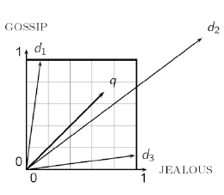
Similarity Measure
Euclidean Distance? – Bad Idea
The Euclidean distance between q and d2 is large even though the distribution of terms in the query q and the distribution of terms in the document d2 are very similar

Slide 27
Similarity Measure
Experiment: Take a document d and append it to itself Call this document d’.
Semantically d and d’ have the same content
The Euclidean distance between the two documents can be quite large
The angle between the two documents is 0 corresponding to maximal similarity
Key idea: Rank documents according to angle with query

Slide 28
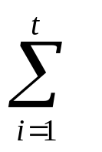
Similarity Measure: Inner Product
Similarity between vectors for the document d_{i} and query q can be computed as the vector inner product:
sim(d_{j},q) = d_{j}•q = w_{ij} · w_{iq}
  where w_{ij} is the weight of term i in document j and w_{iq} is the weight of term i in the query
For binary vectors, the inner product is the number of matched query terms in the document
For weighted term vectors, it is the sum of the products of the weights of the matched terms

Slide 29
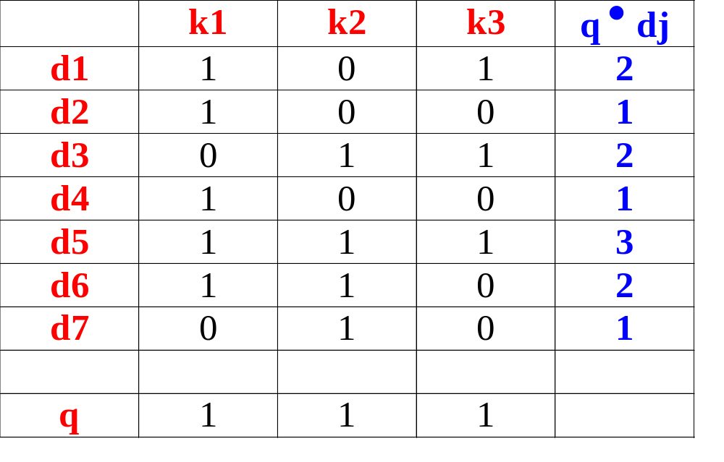
k2
k1
d7
d2
d6
Inner Product: Example 1
d4
d5
d3
d1
k3

Slide 30
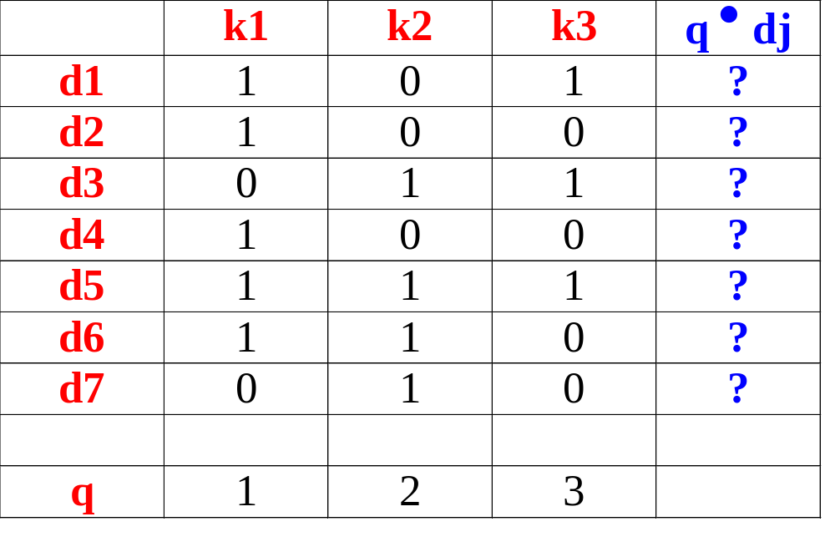
k2
Inner Product: Exercise
k1
d7
d2
d6
d4
d5
d3
d1
k3

Slide 31
Length Normalization - Cosine similarity
Distance between vectors d₁ and d₂ captured by the cosine of the angle x between them.
Note – this is similarity, not distance
t ₃
d₂
d₁
θ
t ₁
t ₂

Slide 32
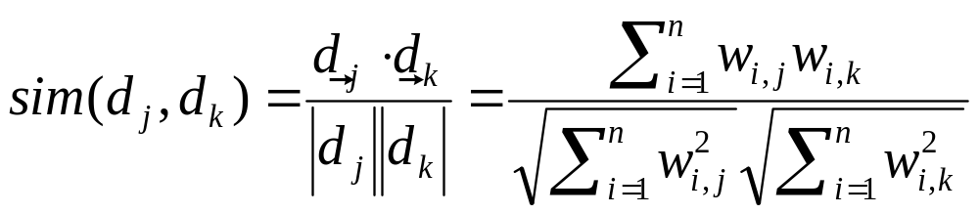
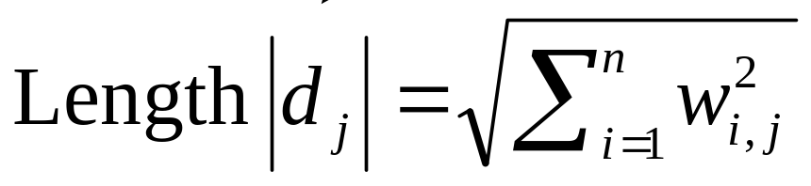
Cosine similarity
Cosine of angle between two vectors
The denominator involves the lengths of the vectors
So the cosine measure is also known as the normalized inner product

Slide 33
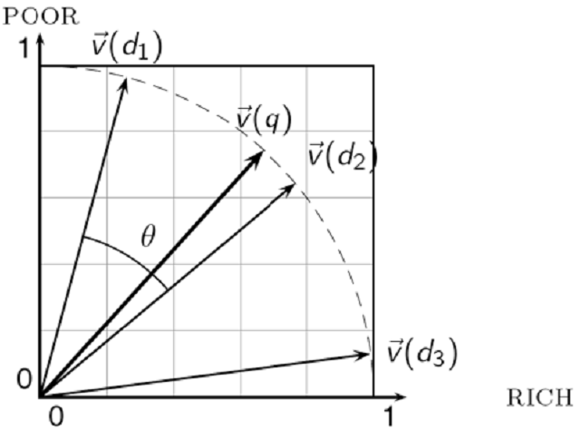
Cosine Similarity

Slide 34
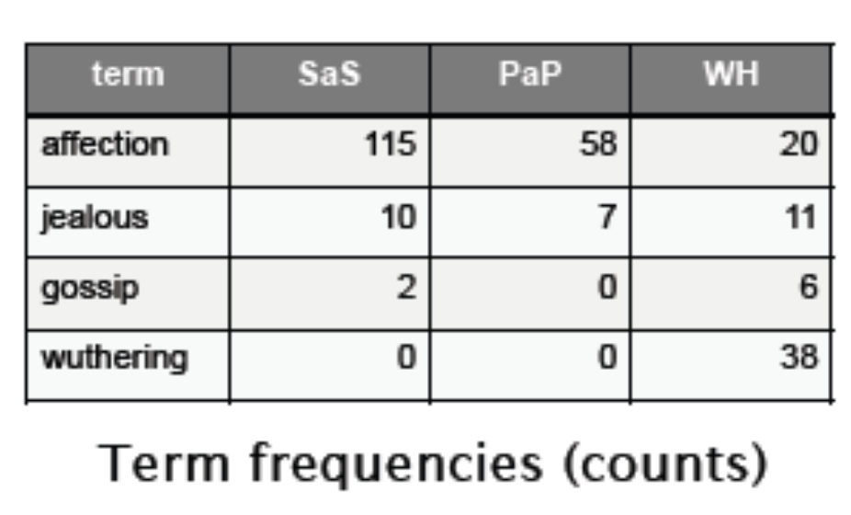
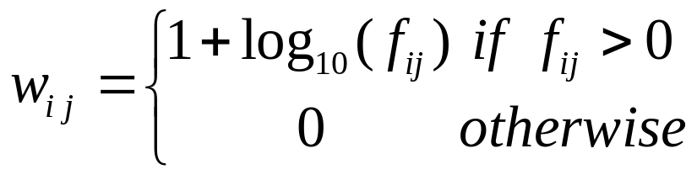
Cosine Similarity
How similar are the novels:
SaS: Sense and Sensibility
PaP: Pride and Prejudice, and
WH: Wuthering Heights?
Note: To simplify this example, we don’t do idf weighting.
For tf weighting we use:

Slide 35
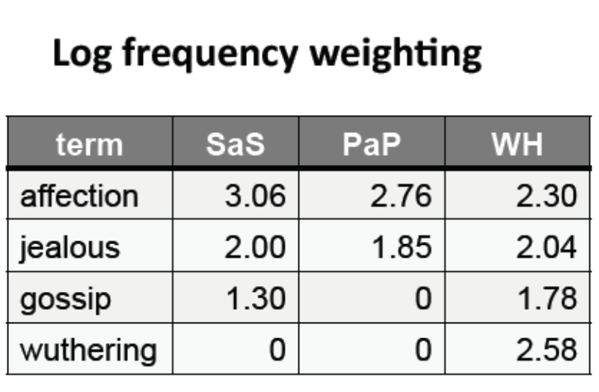
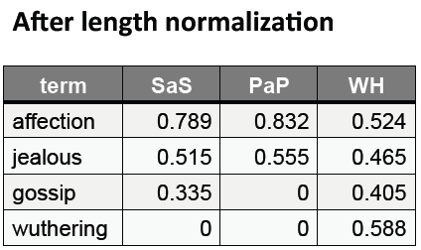
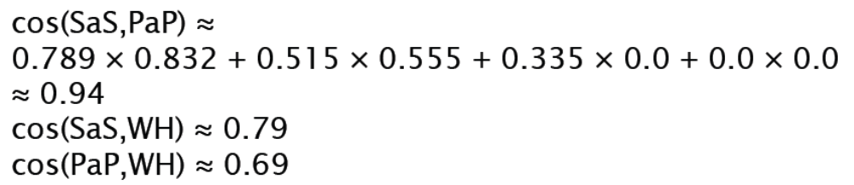
Cosine Similarity

